Slide 1
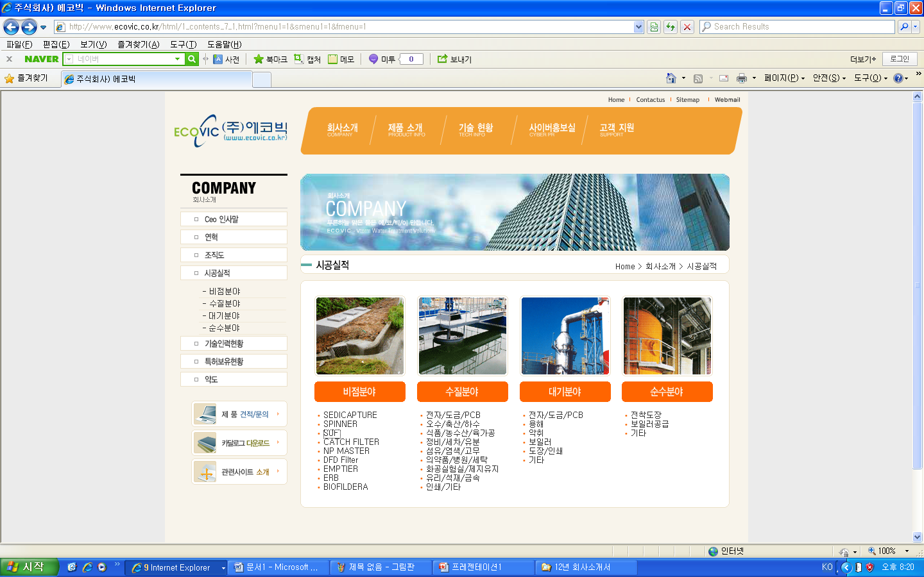
납품실적 페이지를 만드는데 견본사이트

Slide 2
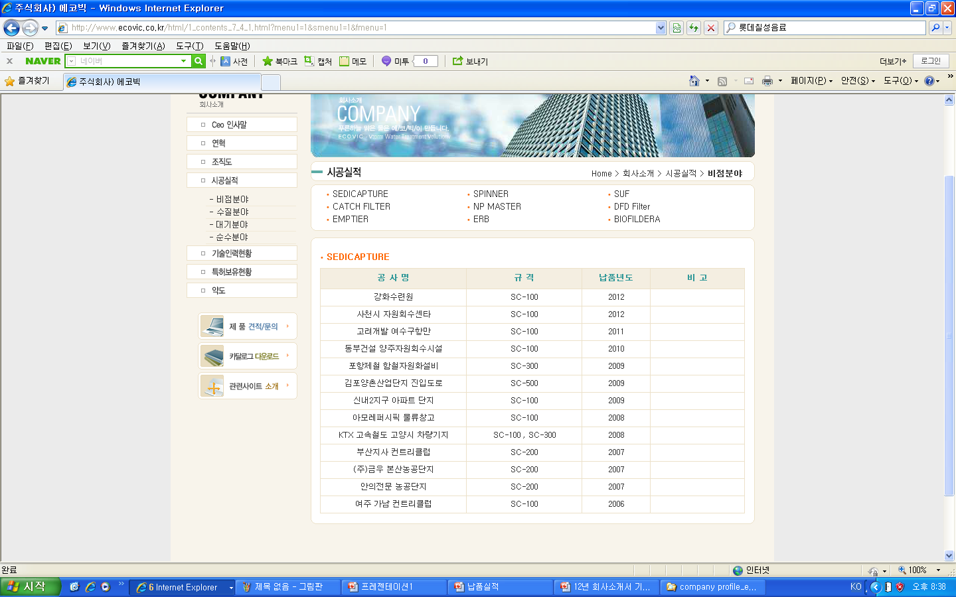
납품실적 페이지를 만드는데 견본사이트

Slide 3
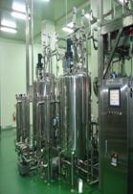
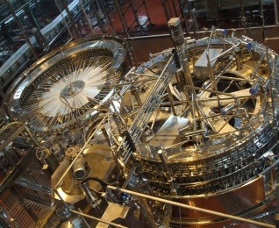
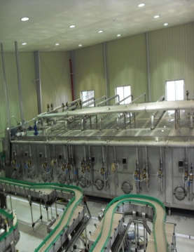
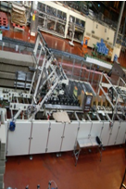
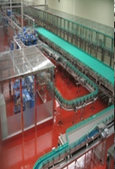
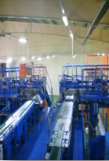
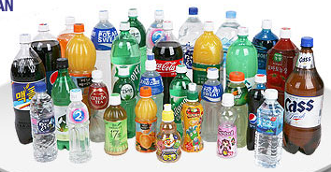
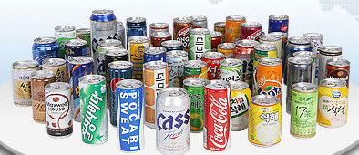
Processing
Filling system
Pasteurizing
Packaging
Conveying
Palletizing
클릭하면 다음페이지의 형식의 납품실적이 나오게 한다.

Slide 4
Major acheivements
ASEPTIC SYSTEM
(Year 2012)
COMPANY | LOCATION | PRODUCTS | YEAR | NOTE
Maeil Dairies co.Ltd | Kyungsan | 1,5000L x 11 | 2000 | MILK (ESL)
Maeil Dairies co.Ltd | Chungyang | Over pressure facility | 2002 | MILK (ESL)
Maeil Dairies co.Ltd | Pyungtaeck | 15,000L x 1 (ASEPTIC) | 2002 | COFFEE
Lotte Chilsung | Yangsan | 20,000L x 1 (ASEPTIC) | 2003 | SOY MILK LINE
Maeil Dairies co.Ltd | Yongdong | 20,000L x 2 (ASEPTIC) | 2004 | BANNA MILK
Nature and People | Damyang | 18,600L x 4 (ASEPTIC) | 2006 | VEGETABLE JUICE
Maeil Dairies co.Ltd | Youngdong | 20,000L x 2 (ASEPTIC) | 2006 | SOY MILK & MILK
Samyoung system | Jinchun | 16,000L x 1 (ASEPTIC) | 2006 | VEGETABLE JUICE
Samyoung system | Jinchung | 16,000L x 2 (ASEPTIC) | 2007 | VEGETABLE JUICE

